Slide 1
Analysis Week 6

Slide 2
Final Project
Collected, cleaned dataset with
Metadata breakdown
Narrative of the dataset
Usage examples
Basic analysis
Credits
Distributed to a repository (potentially!)
Pitching them to grad student panel for feedback during class for Week 9 (October 21)

Slide 3
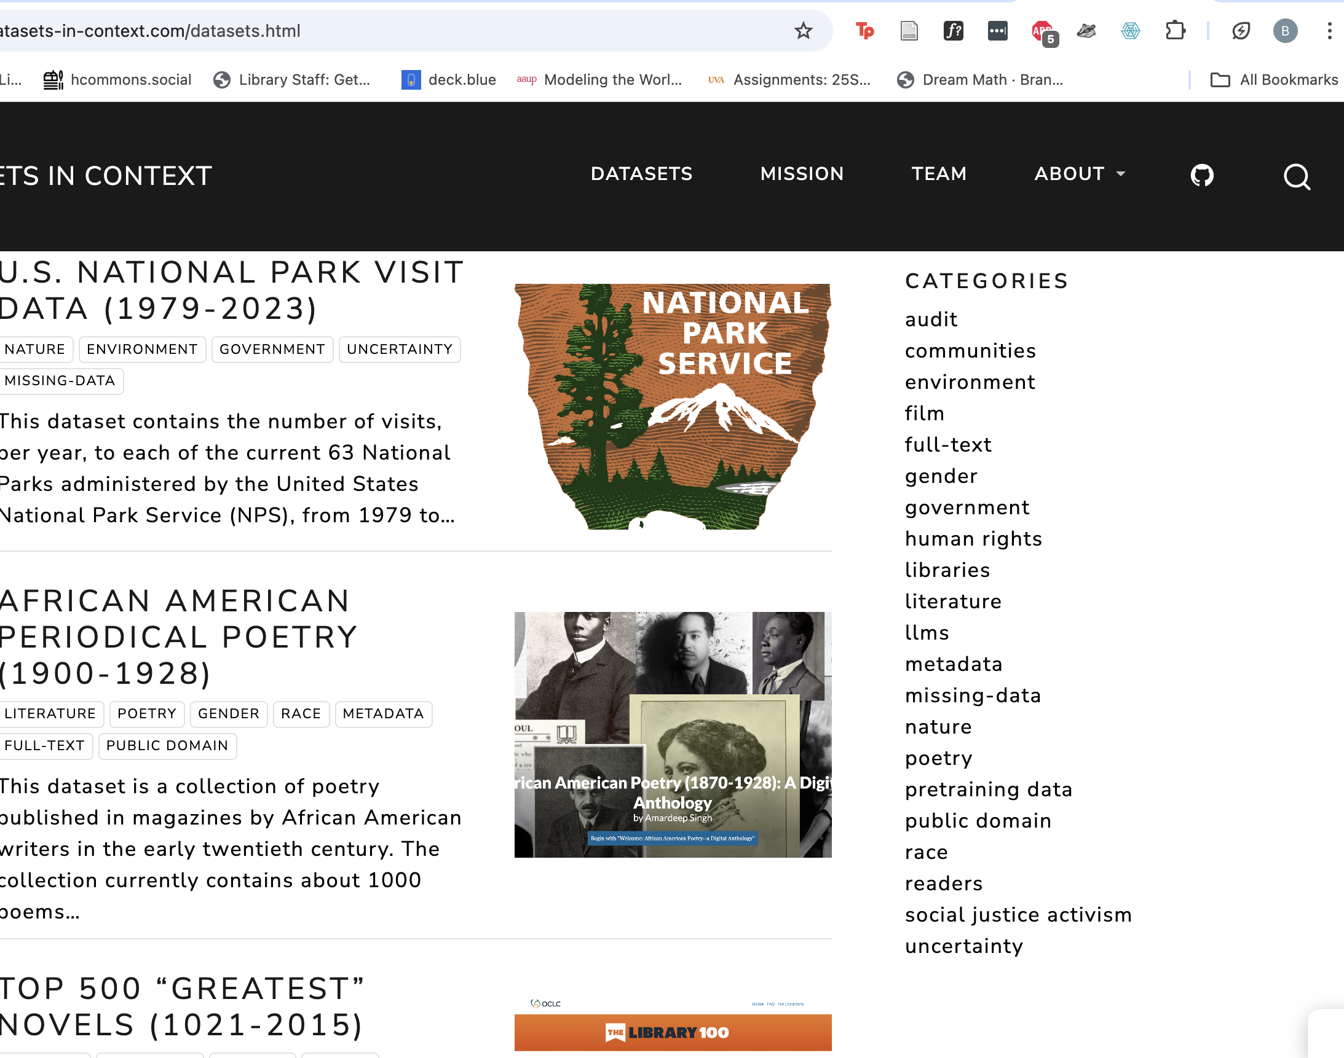
https://www.responsible-datasets-in-context.com/datasets.html

Slide 4
Some Advice
Think small/mid – interesting but doable
Things that don’t require a login or typing into a search interface
Government sites and big corporations potentially too large or fraught
Look at terms of service
Avoid human subjects
Ask me if you have questions
Example:
Scraping all national park service—too much!
Scraping daily progress for stories about climate from 2000-2010—More doable!

Slide 5
Types of Analysis
Qualitative
Quantitative
What did the reading have to say about these?
Notes:
Answer in pairs

Slide 6
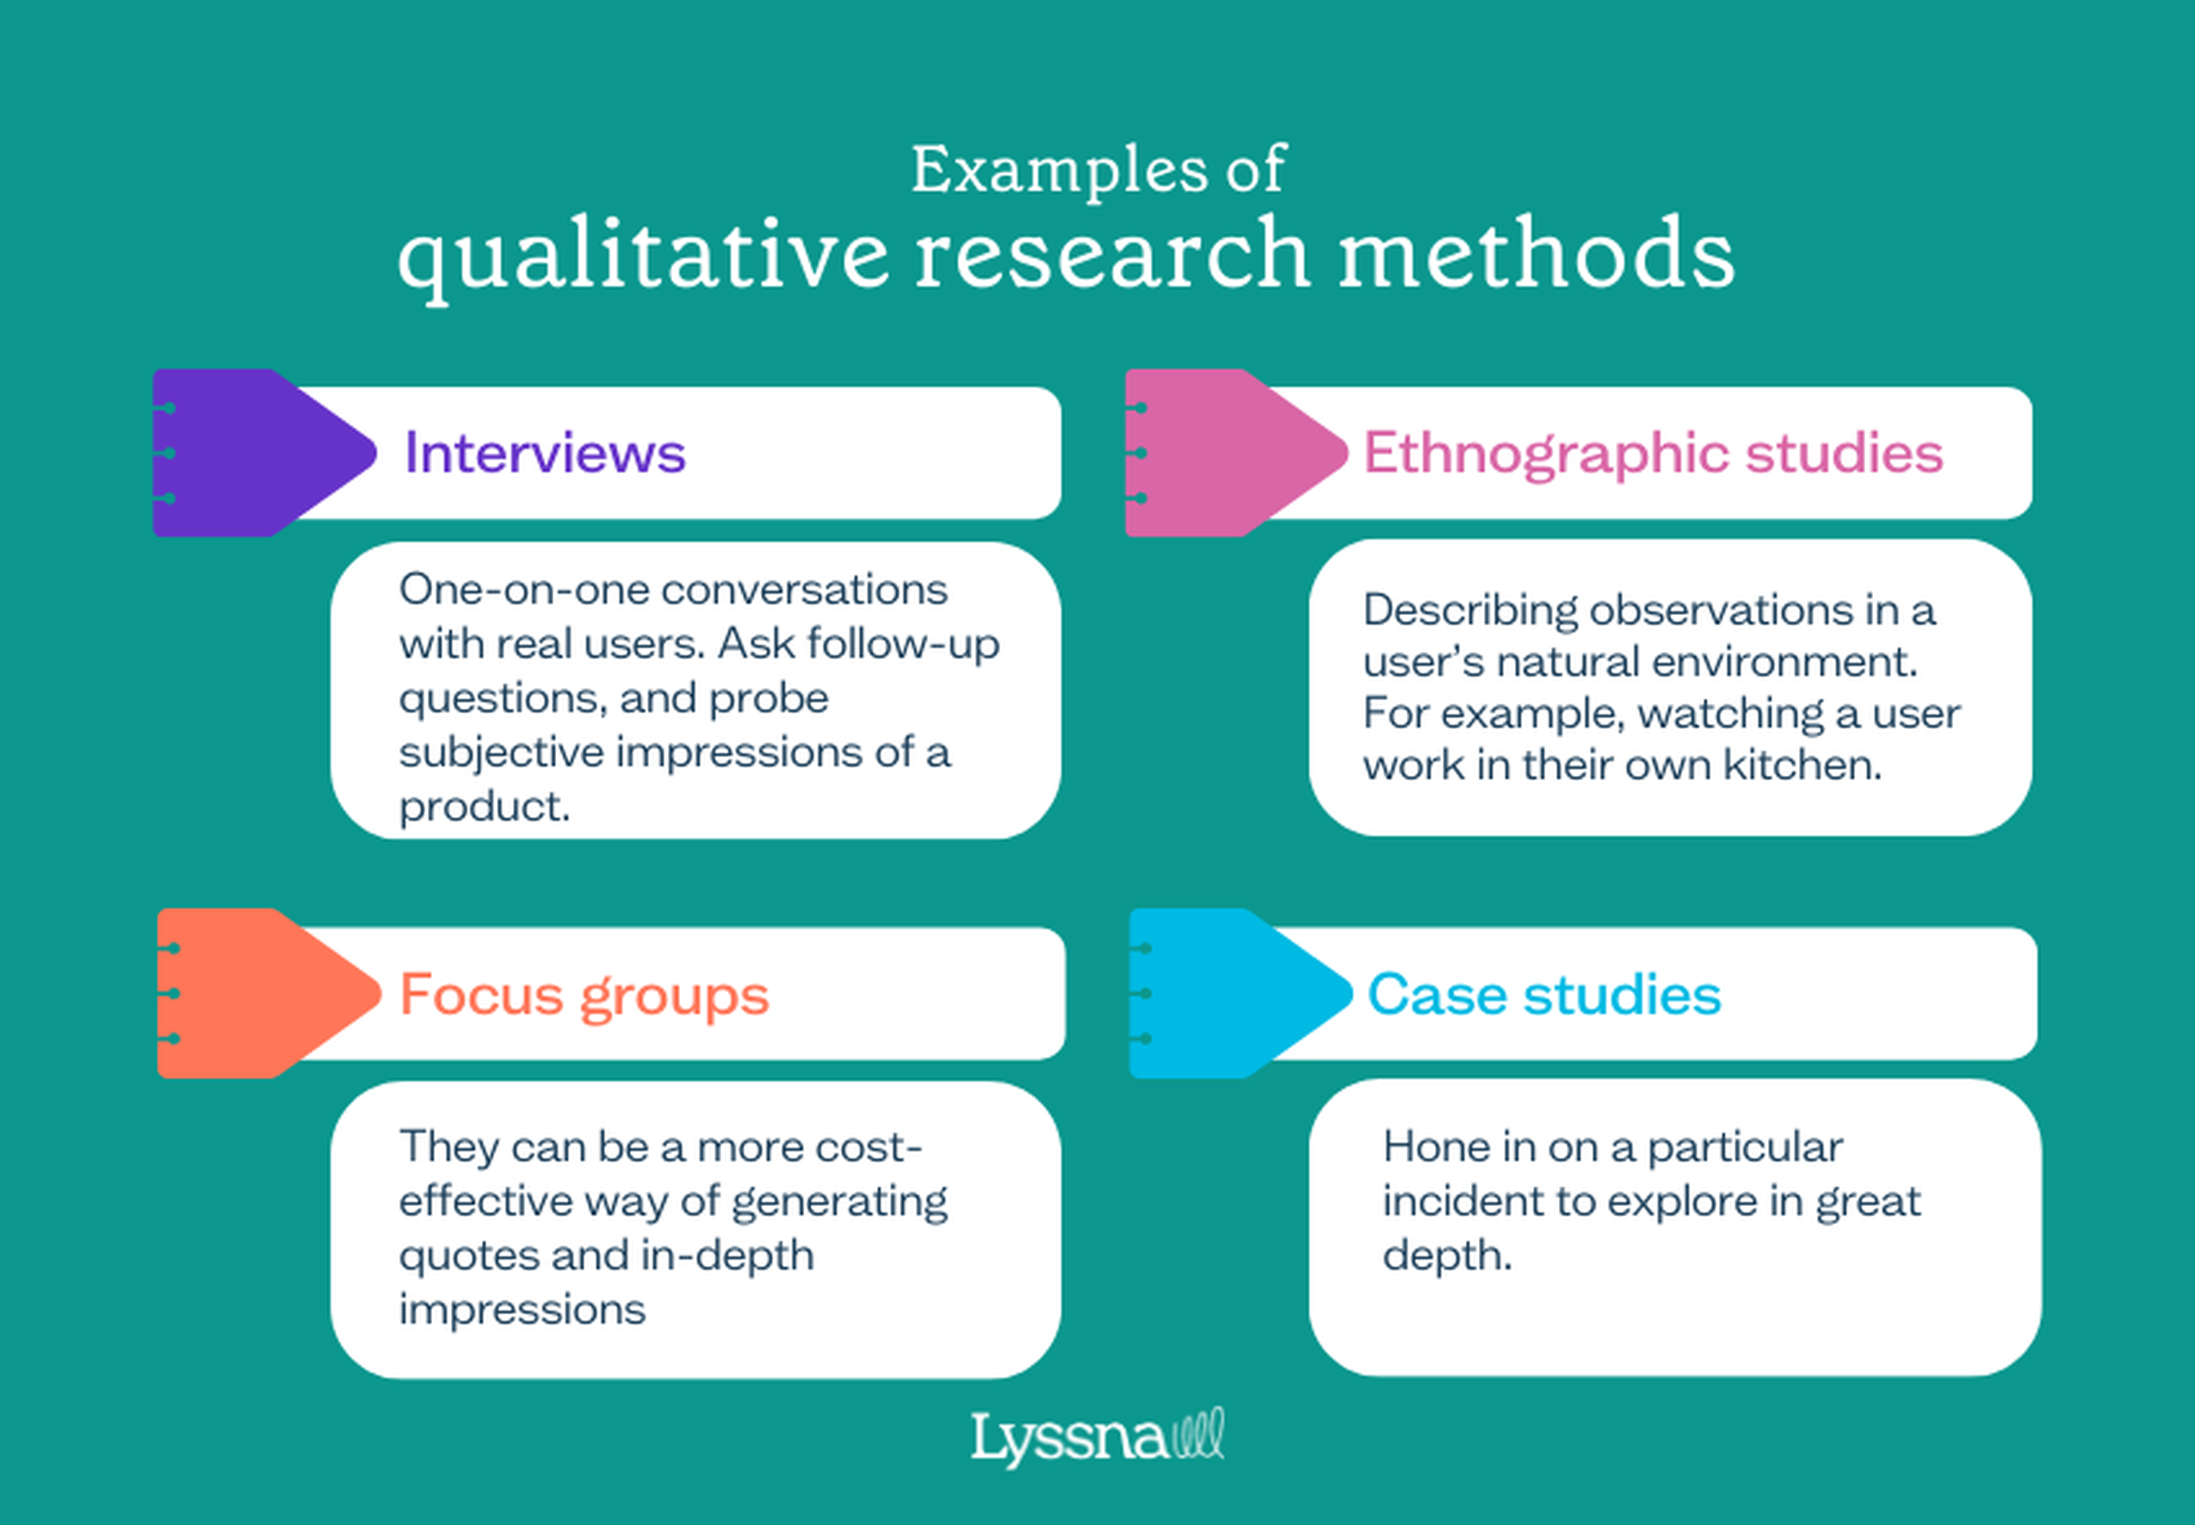
Notes:
https://www.lyssna.com/blog/qualitative-vs-quantitative-research/
Generally about working with messy, case study oriented, experiental evidence. Slow

Slide 7
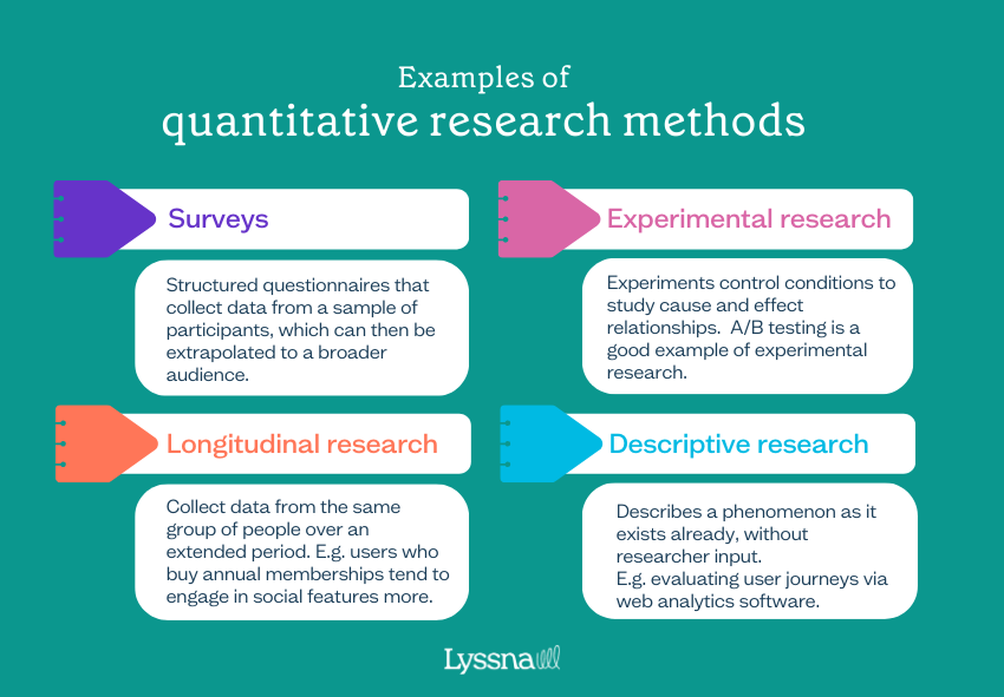
Notes:
From https://www.lyssna.com/blog/qualitative-vs-quantitative-research/
Measurable, at scale, takes a long time

Slide 8
Types of Analysis
Qualitative
Quantitative
Exploratory
Explanatory

Slide 9
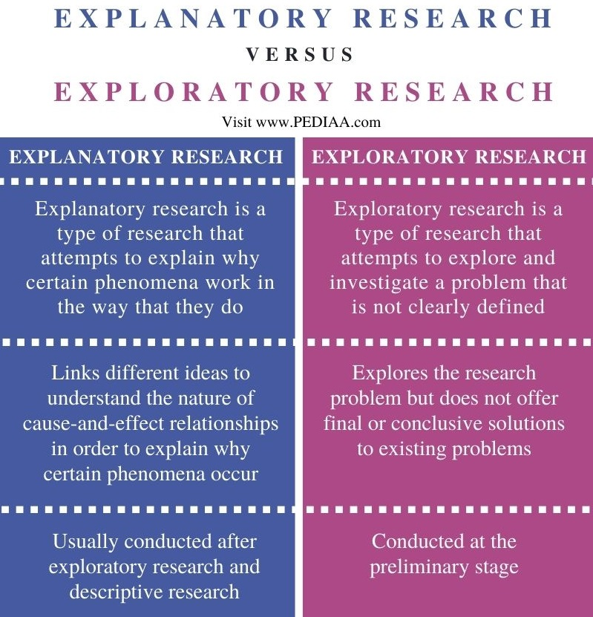
Notes:
https://userinput.io/customer-research/exploratory-vs-explanatory-research/

Slide 10

Notes:
https://slideplayer.com/slide/10513247/

Slide 11
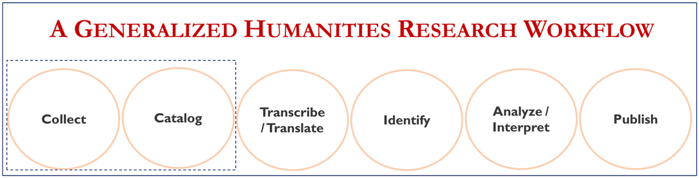
Notes:
https://www.researchgate.net/figure/A-generalized-humanities-research-workflow-It-contains-six-circles-to-represent-the_fig1_364245293

Slide 12
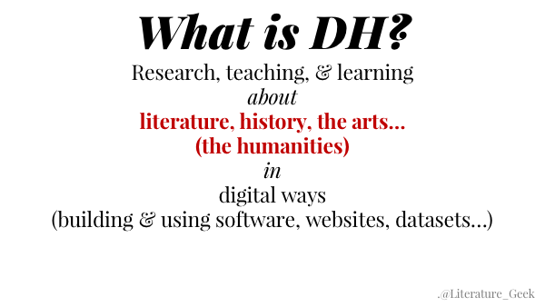

Slide 13
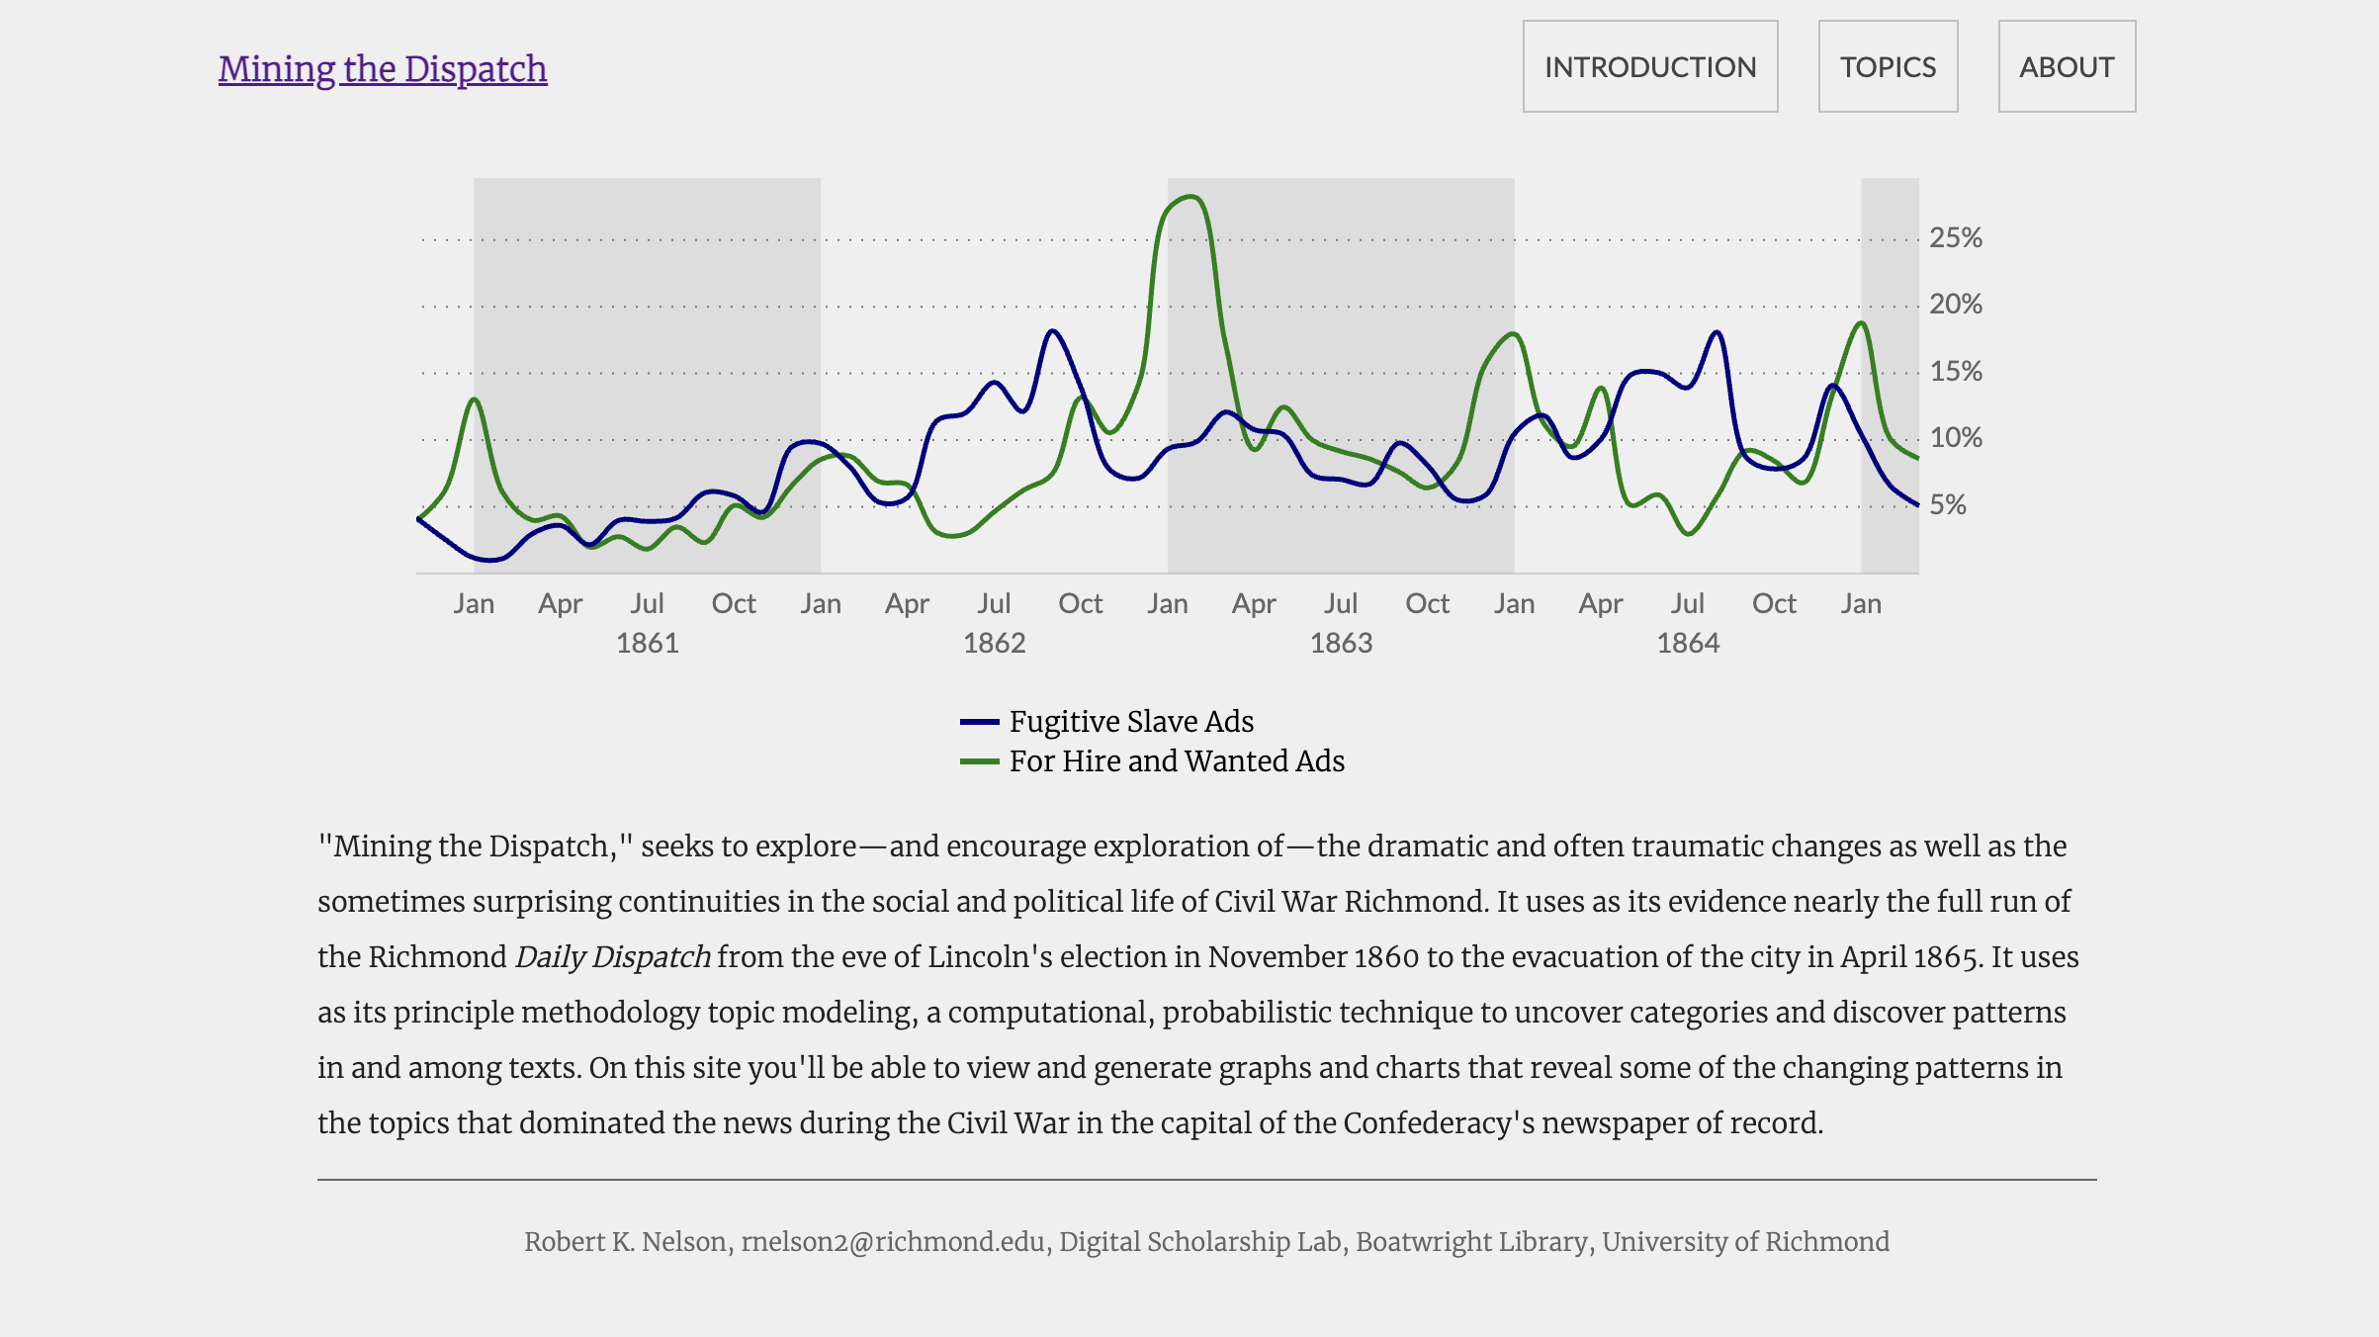
Notes:
https://dsl.richmond.edu/dispatch/

Slide 14
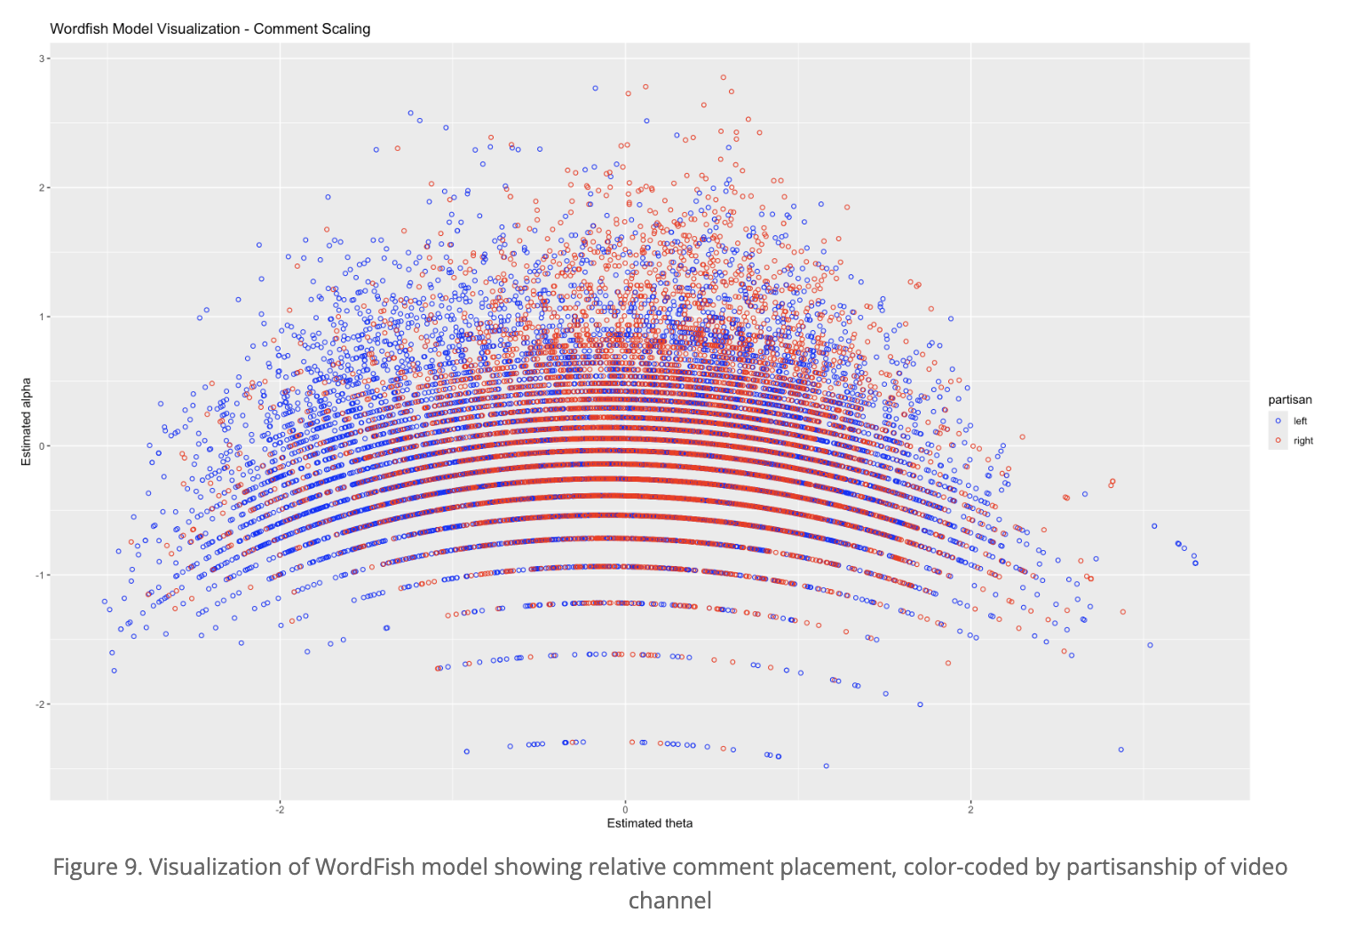
Notes:
https://programminghistorian.org/en/lessons/text-mining-youtube-comments
Using a particular software package to code youtube comments for their political leanings

Slide 15
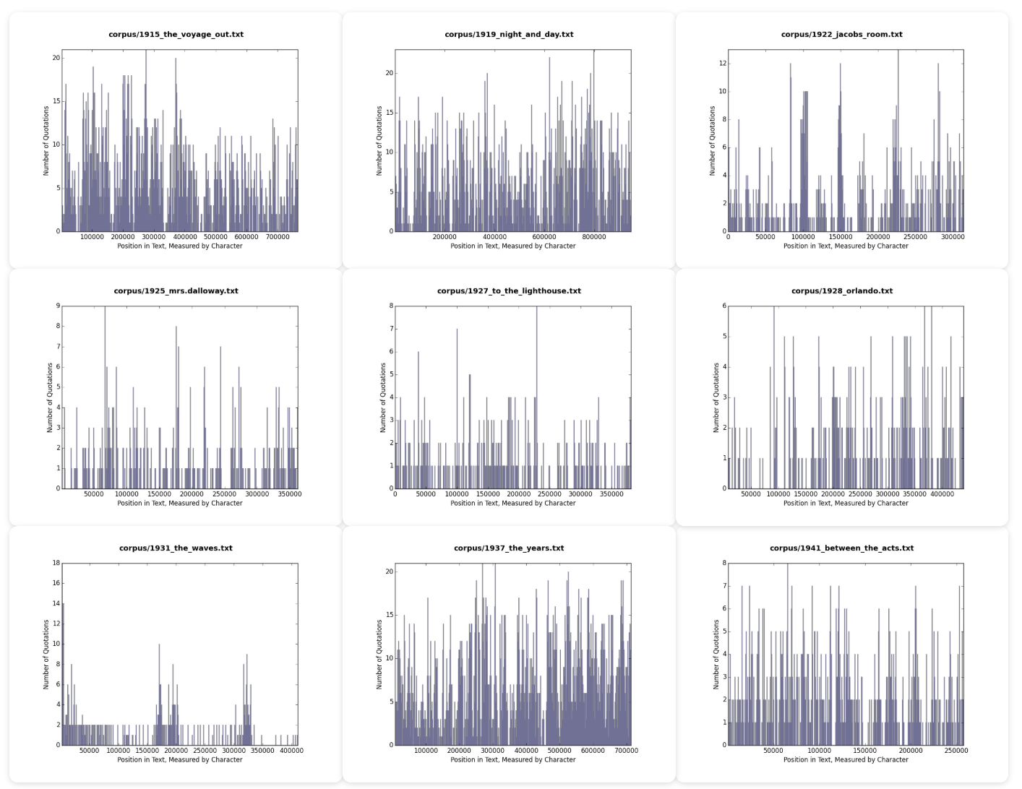

Slide 16
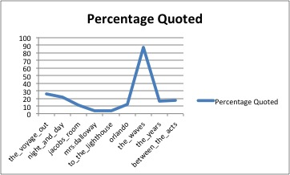

Slide 17
Looker Studio
Data analysis is a HUGE area – we are going to just scratch the surface
Often requires programming
Limited here by
Experience
Technical skill
Cost of tools

Slide 18
Types of Analysis
Qualitative
Quantitative
Exploratory
Explanatory
Consider all of these as you work towards final projects.
What story are you trying to tell? It can change in the telling!

Slide 19
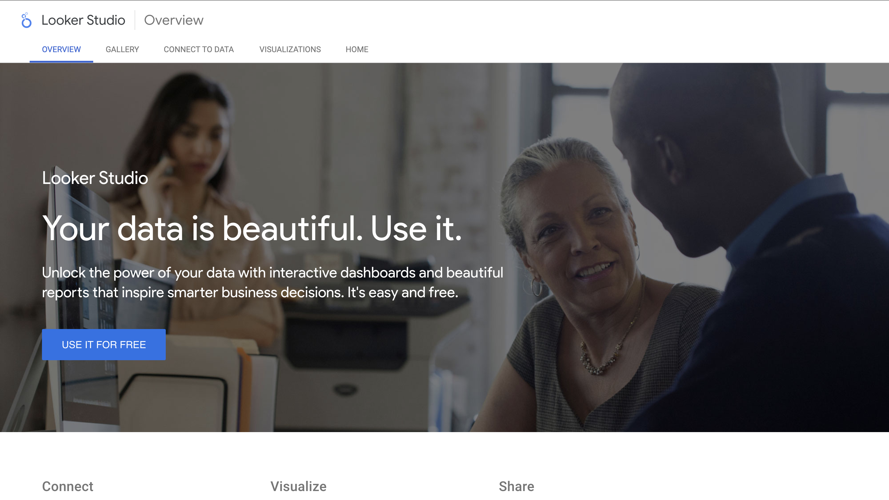

Slide 20
Plan
Upload our data to google sheets
Make a looker studio project
Embed a table
Make a line graph
Make a scatterplot
Play in groups
Share

Slide 21
Upload our Data to Google Sheets
Will require a gmail account
Doesn’t have to be your real one
One of the tradeoffs here – this is free because google wants your data
Go to sheets.new in a browser.
File -> import -> upload from your computer
Upload the unzipped audible cleaned dataset.
Available at https://walshbr.com/data-for-the-rest-of-us/week-5-cleaning/
Should now be part of your google drive account

Slide 22
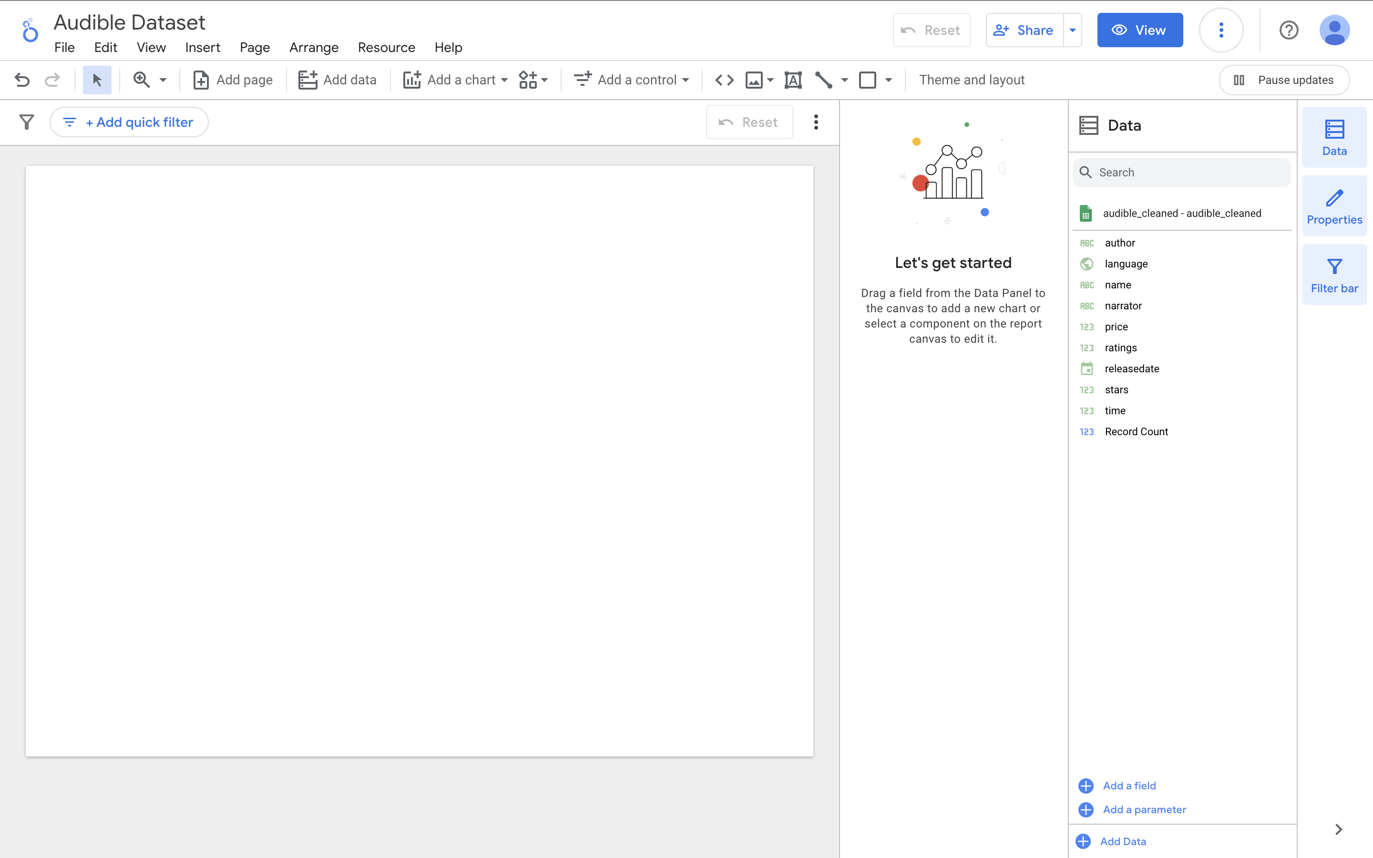
Make a New Project and Add Our Data
https://lookerstudio.google.com/
Click new blank report
Will ask you to give a location and company
Opt out of all emails
But then at the end of the day should bring you here
Click “add data” -> google sheets
You will have to authorize it
You should be able to find the audible dataset if it’s on your google drive. If not, upload it
Now we have our audible data in the report

Slide 23
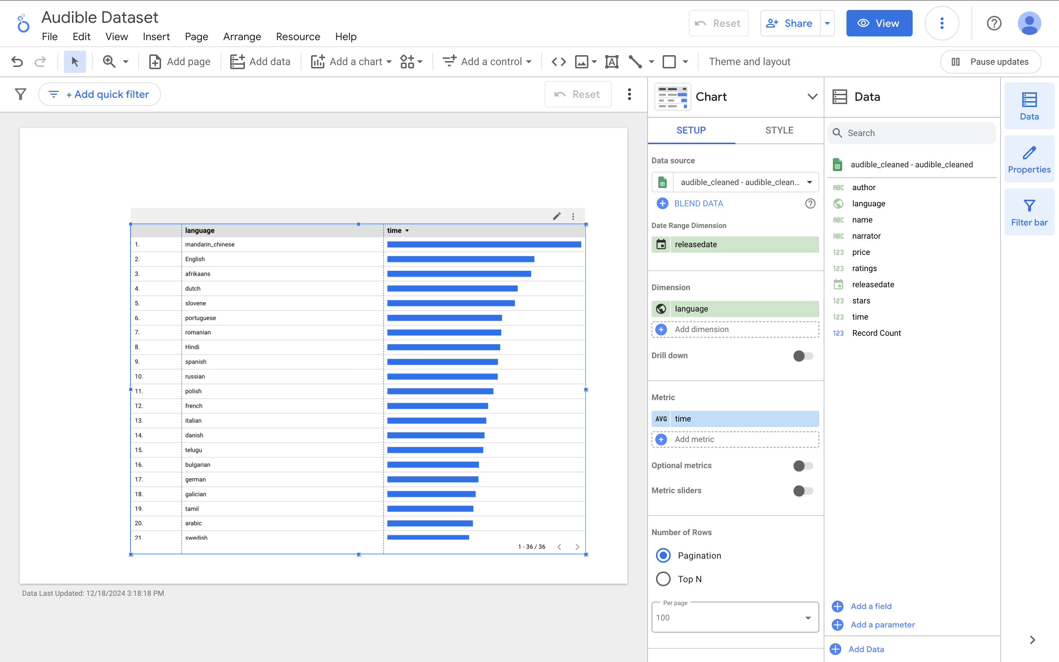
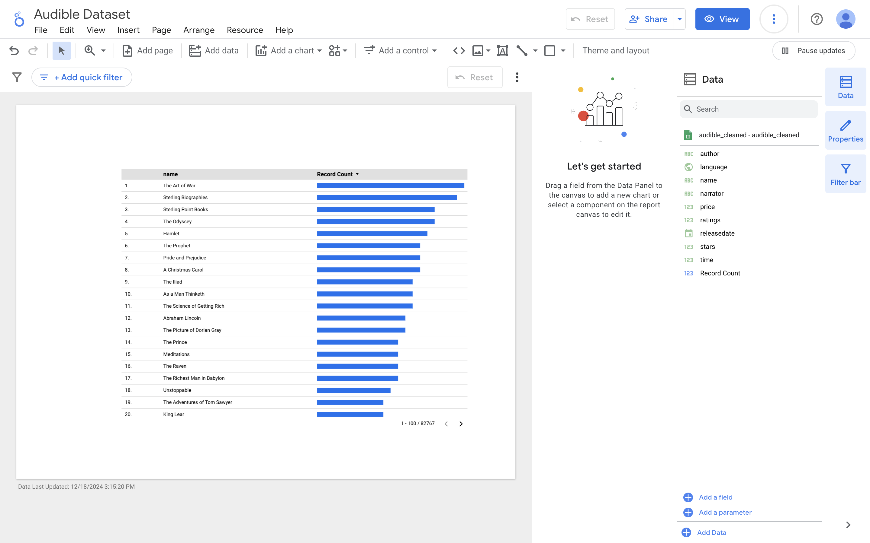
Adding a Table
Click “add a chart” ->“Table with Bars” and place your chart in one corner of the report.
Note the dimensions and axes if gives you by default – you will often want to change them.
By default I got a chart of most common authors (you might have gotten something else). Let’s modify settings from top to bottom.
Dimension = language.
Metric Time
Change sum or aut to AVG
Pay attention not just to the metrics but also to whether they are raw counts/sums/avg
Result is that we have a graph for how long, on average, the typical audiobooks are for each language
Let’s also drag over the “name” field from the data pane to get a list of book titles

Slide 24
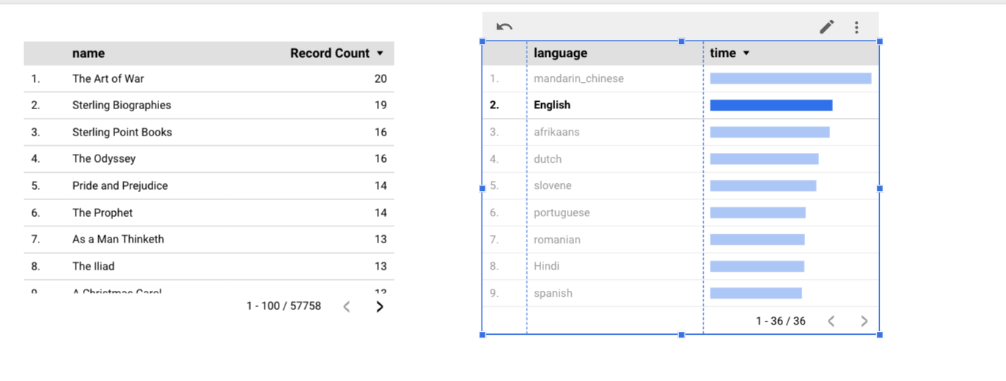
Filtering
When you load in your data it should give you table of the results by default.
Everything is connected, so if we click a language row from our new visualization it will update the table.
I.e. if we click “English” it will show us the longest English novels in the collection.
Click the names chart and update metric to be time, then average.
Now we see what the longest books are.
Play for a second – what did you find?

Slide 25
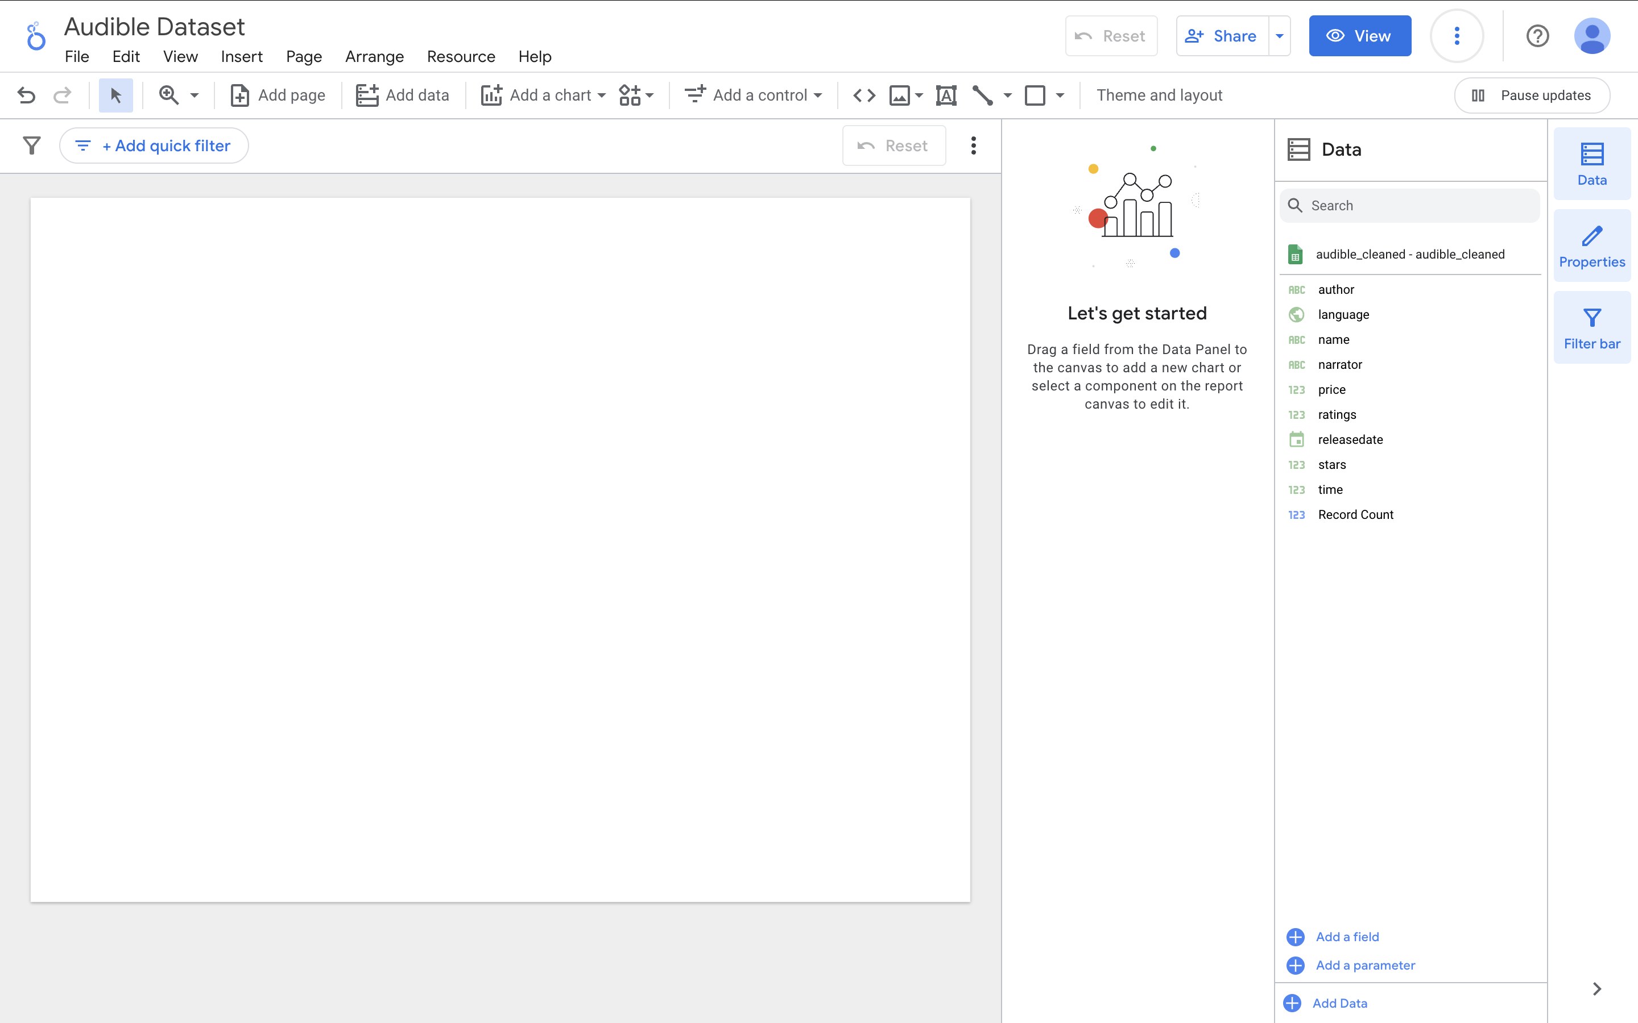
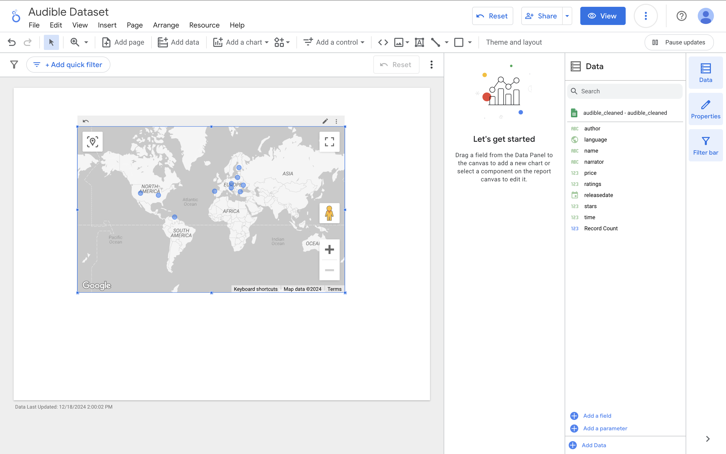
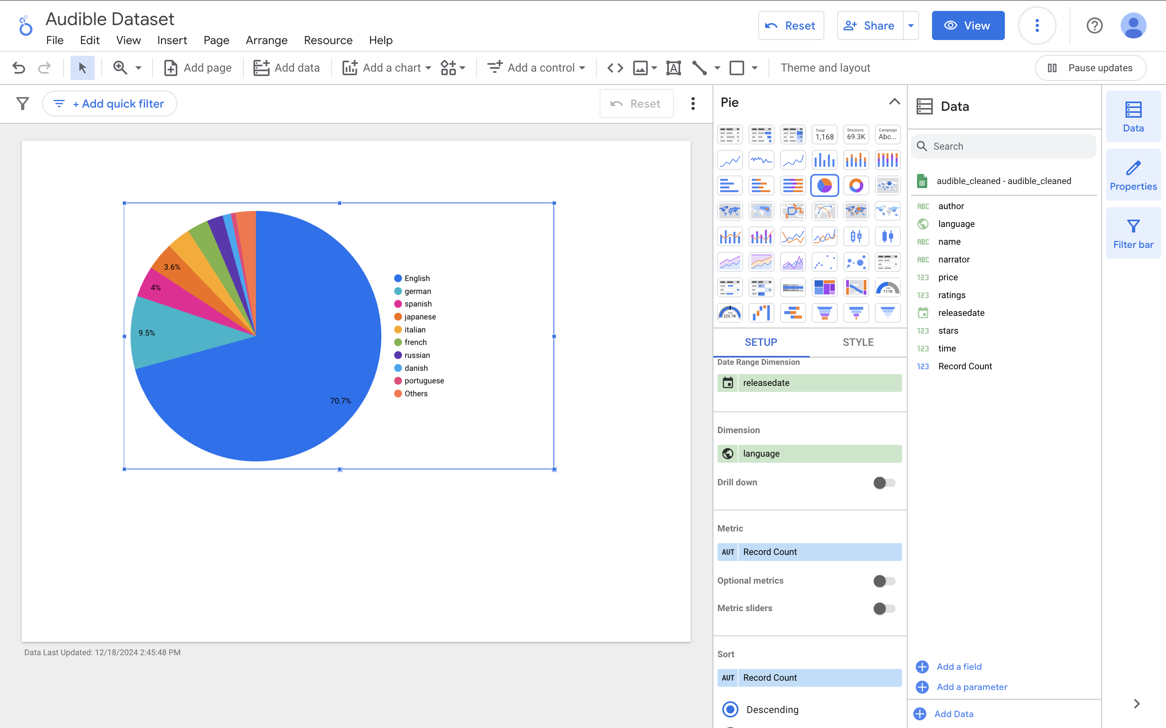
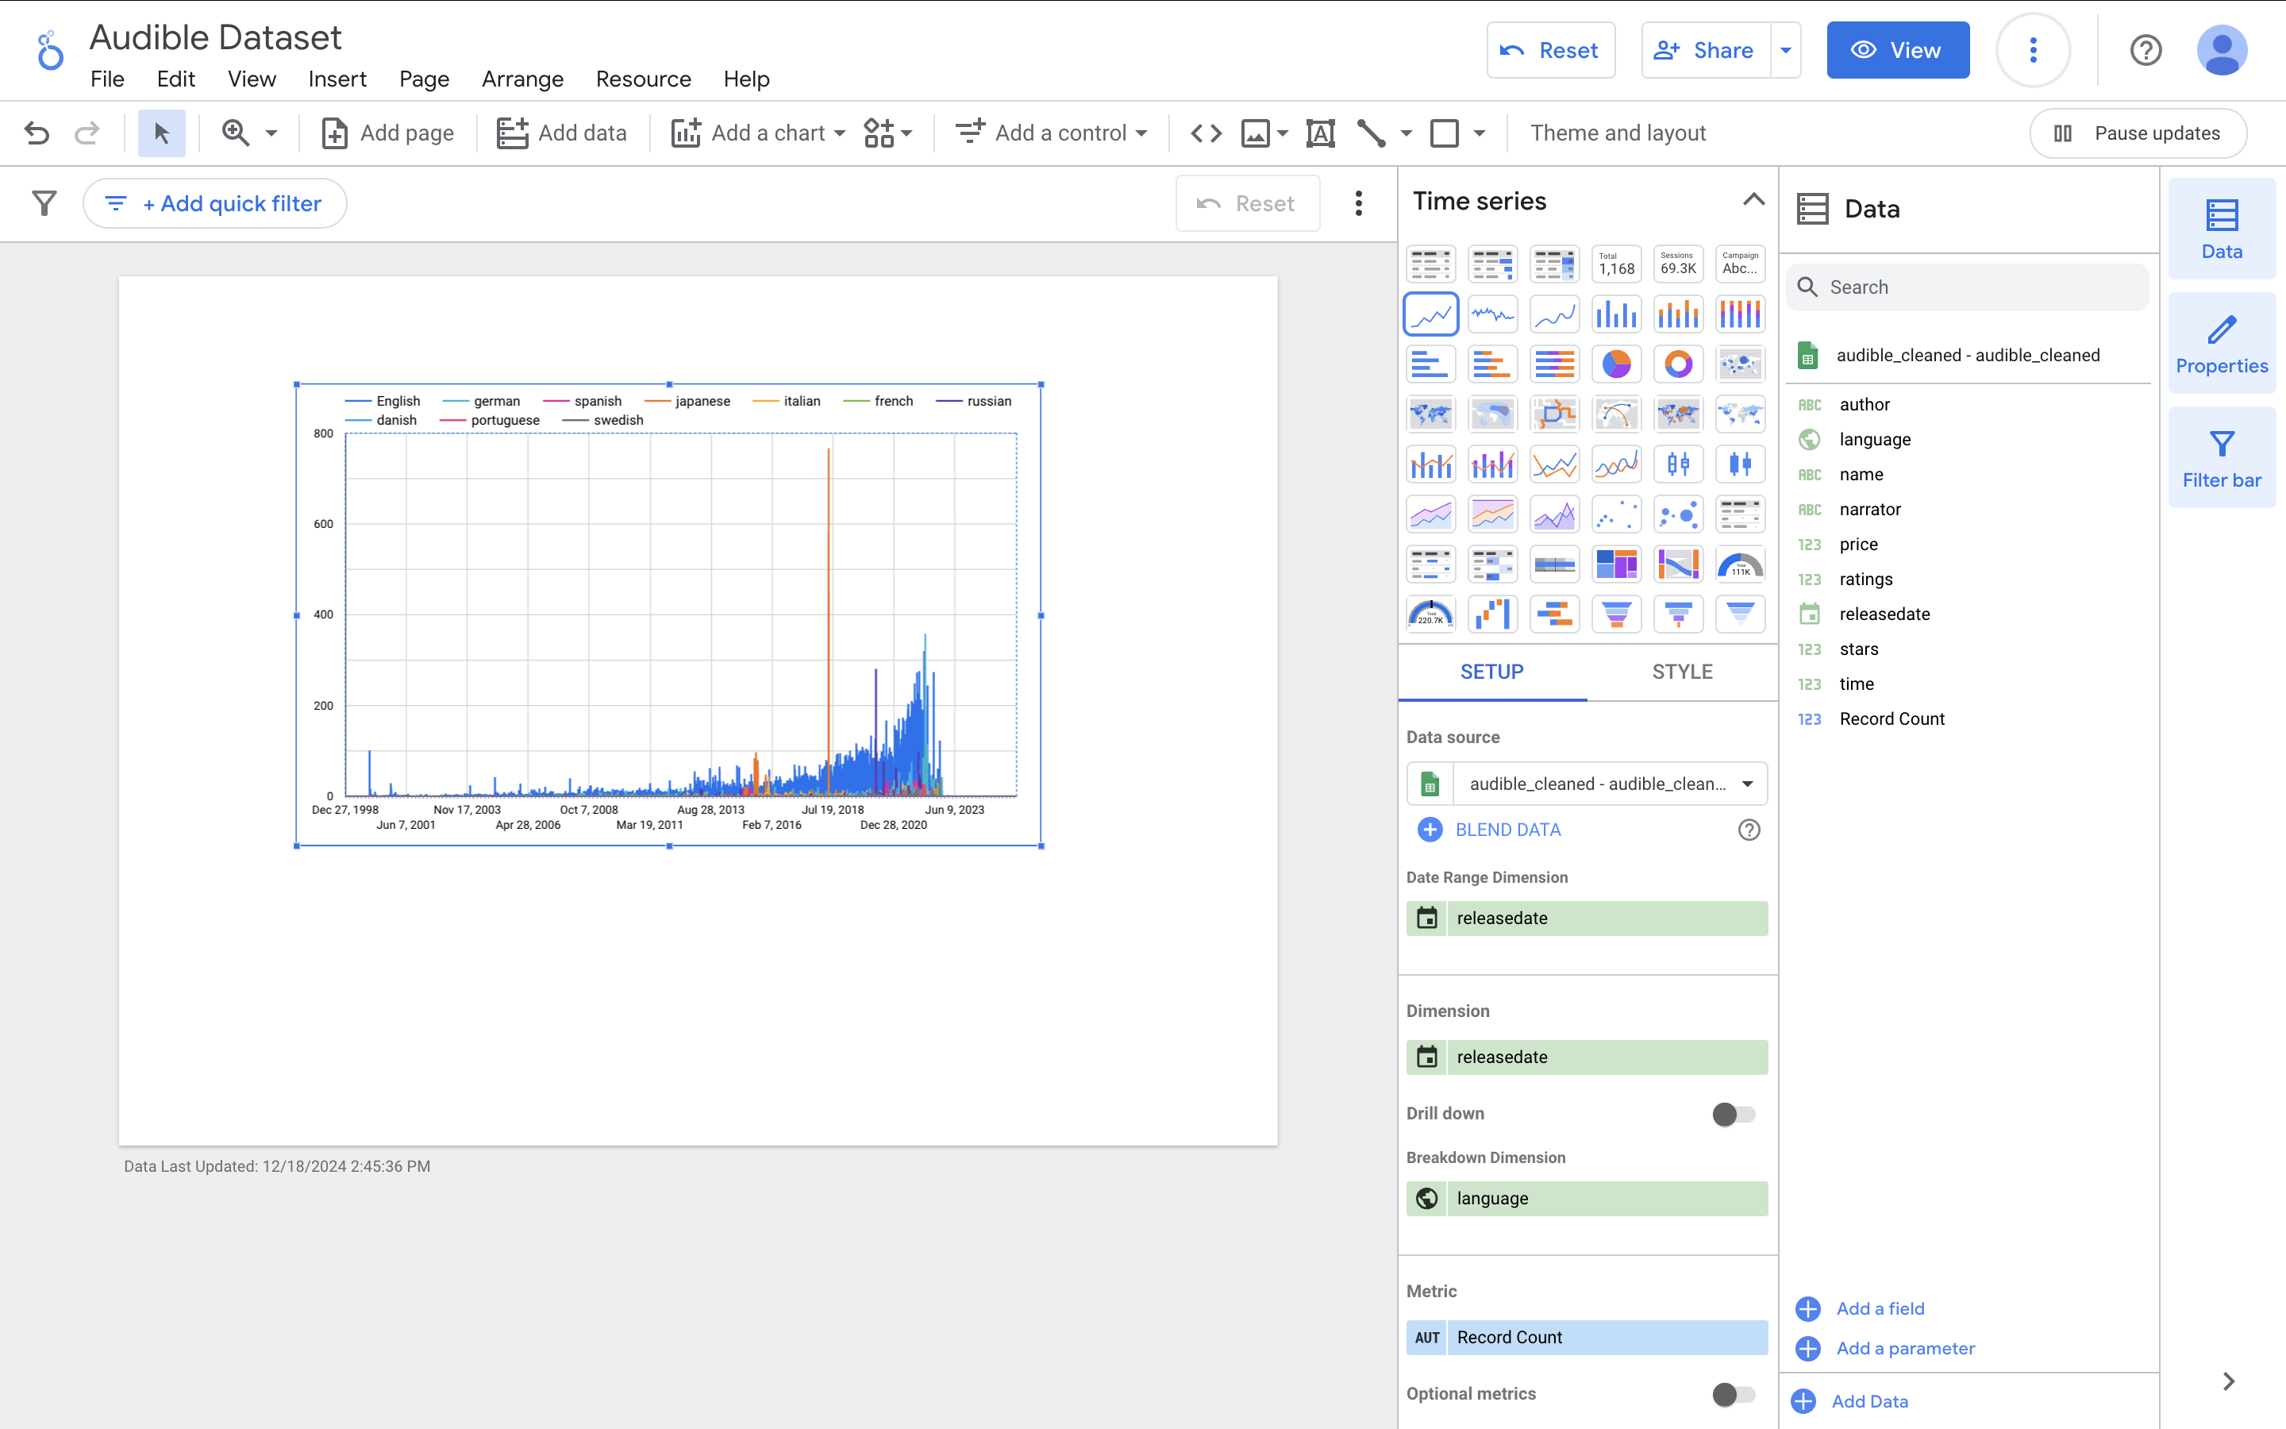
Language Graphing
Drag a data field over. Let’s grab “language”
Expand the chart and click it
Click Chart type and change it to a pie chart
Then again to a time series
Google will infer a lot!
Time series chart is pretty hard to read though.
Calendar icon to left of dimension -> click ”date” under data type -> try year month and year
What happened?
In general, think:
What am I trying to do?
What appears to look wrong?
What specific thing might be applying that?

Slide 26
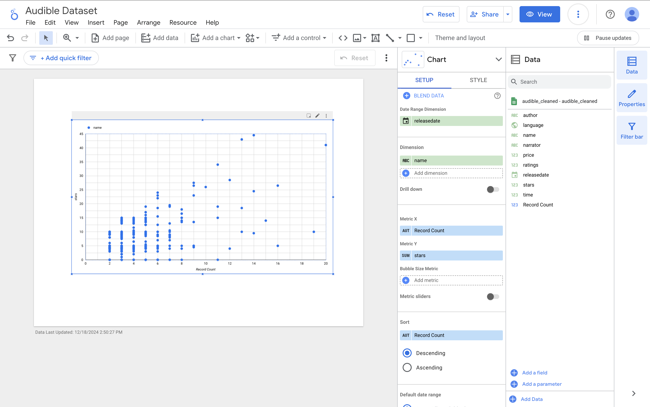
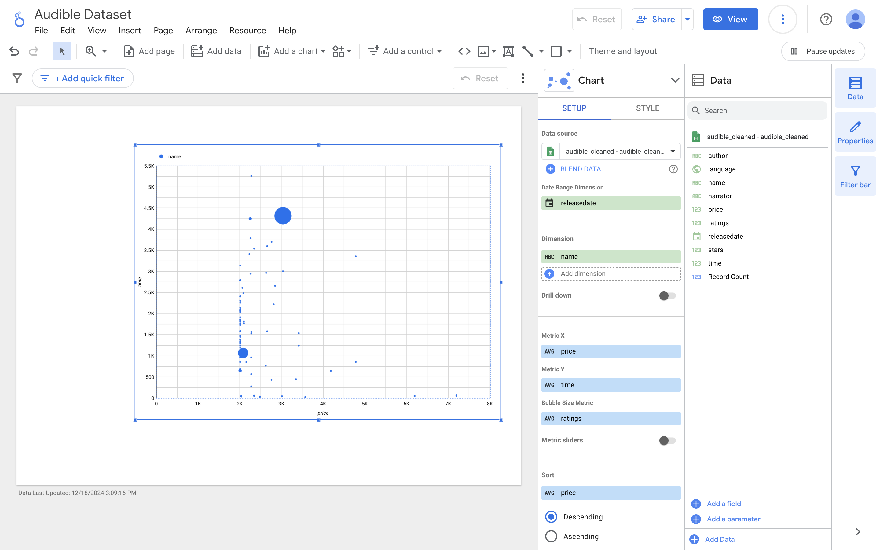
Adding a Scatterplot
Click “add a chart”
Scroll and select “scatter”
Note the dimensions and axes we want to change them.
Dimension: name - > date
X: avg – price
Y: avg – time
Try playing around by changing these values and also the style menu
Add dimension - > language
Click style – bubble color -> language.
-> color by dimension values
Any concerns or thoughts? What do you notice?
Notes:
What is the price unit? The time unit?
Hours minutes
Ask them to investigate what the currency is. How did they find out?

Slide 27
Work Time
In small groups play with the tool and see what you can do!
I’ll float to help
In the last few minutes we will share what you come up with with one twist:
We want you to walk through the class how to produce the same visualization.
What do you want to do that you can’t figure out?

Slide 28
Homework
Use Looker Studio to tell a story about the audible dataset. By 9:00 AM Friday upload to canvas a paragraph describing what you see and a screenshot of any visualization that is meaningful to you.
For your final project, come up with three potential data sources to collect and hone into a final project. Upload to canvas by 9:00 AM Friday. For each of them, share a link, a short description, and some keywords describing your interests.
(I’m going to try to group you into like-minded subject areas)

